Slide 1

Multivariate modelling of the dependence structure between article sales of a sportswear manufacturer
Master Thesis – Petros Christanas

Slide 2

Contents
Introduction
Data description
Modelling
summary & outlook

Slide 3

Introduction
Target channel: adidas e-Commerce (eCom) Western Europe
Large collection of online transactions
Thousands of online purchases from the adidas eCom website are completed every week
Recording of the number of sold units for every unique article
Subject of the thesis:
What does the dependence structure of unit sales for different articles look like?

Slide 4
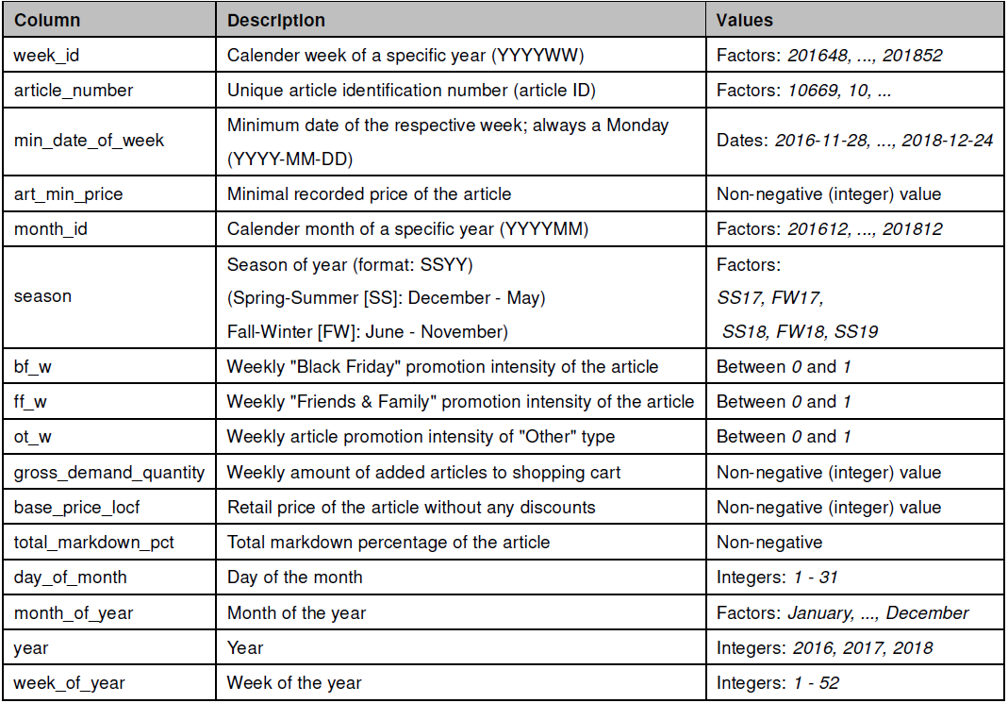
Data description
Transactional data aggregated to weekly level 2017 & 2018
Target variable:
gross demand quantity (unit sales)
Group by variables:
Article number
Week (109 weeks in total)
Other variables of interest:
Promotions
Markdowns

Slide 5
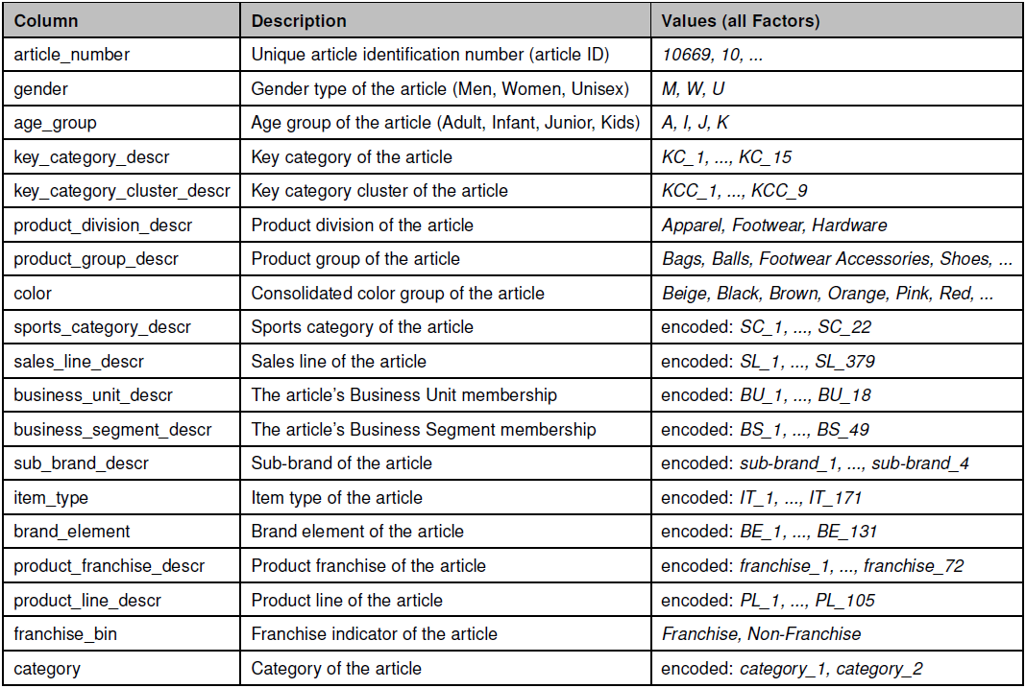
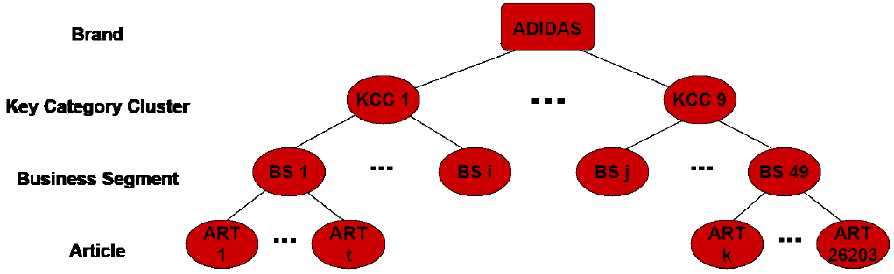
Data description
Article attribute data
Primary key:
Article number
Article attributes have a hierarchical structure
Attributes of interest:
Brand total sales
Key Category Cluster (KCC) - in particular 2, 6 & 8 i.e. aggregated sport/fashion category
Article article number

Slide 6
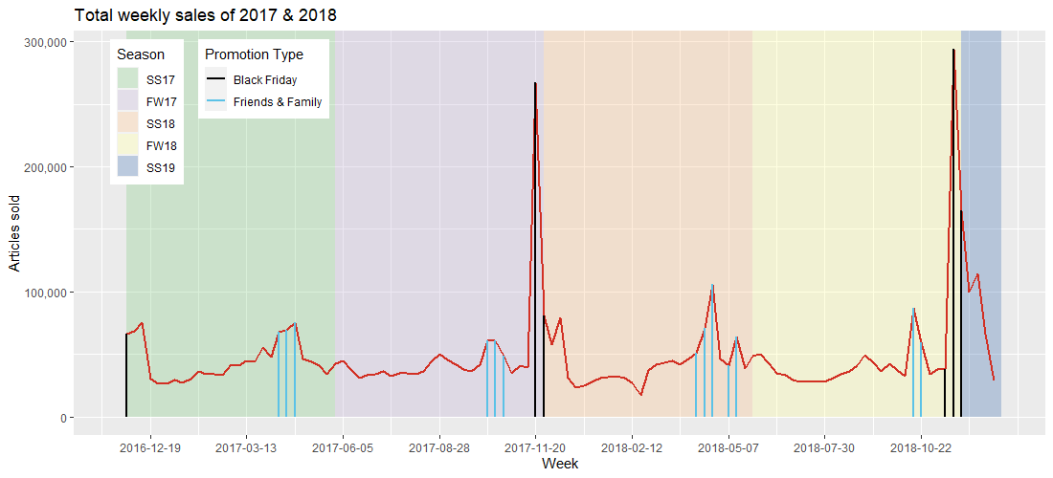
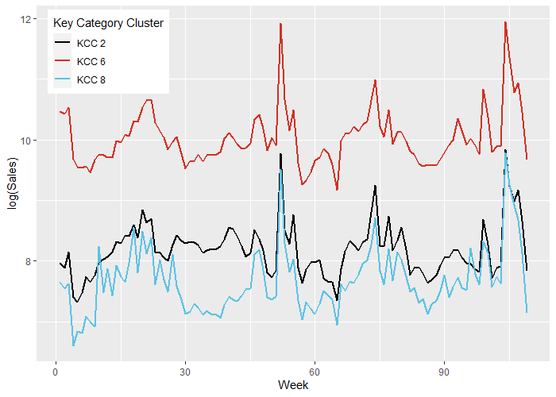
Data description
Total article unit sales:
Huge peacks during „Black Friday“ weeks
Noticeable peaks during „Friends & Family“ weeks
Unit sales of Key Category Cluster in log-scale:
Similar to the total sales, peaks occur during promotion weeks

Slide 7
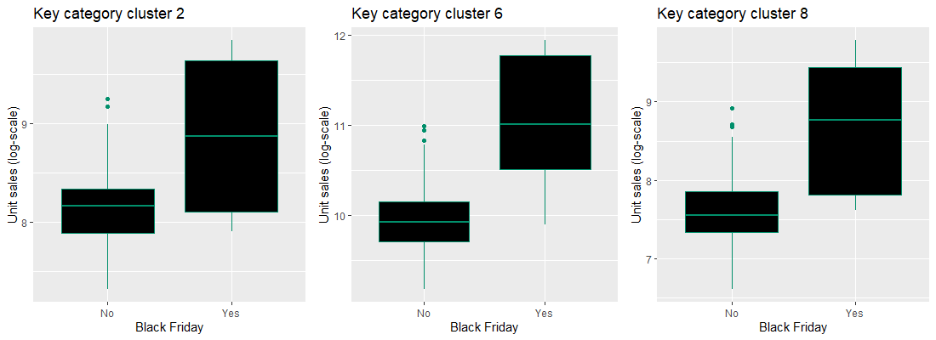
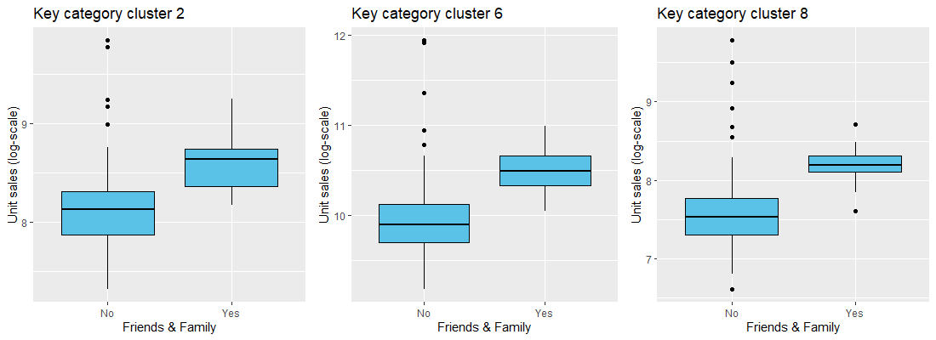
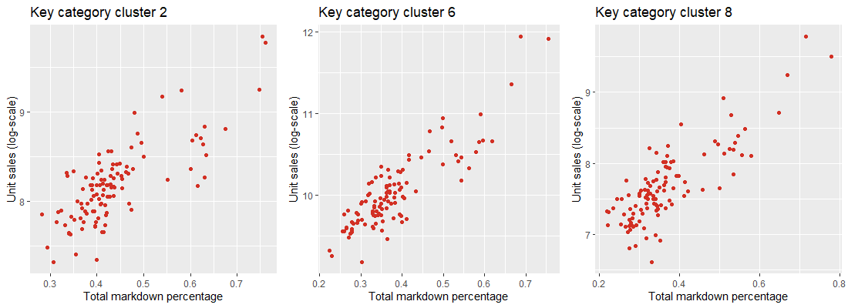
Data description
Log-sales on KCC:
If promos are activated, sales usually are higher
Markdowns go along with higher sales
Joint distributions of Key Category Clusters?

Slide 8
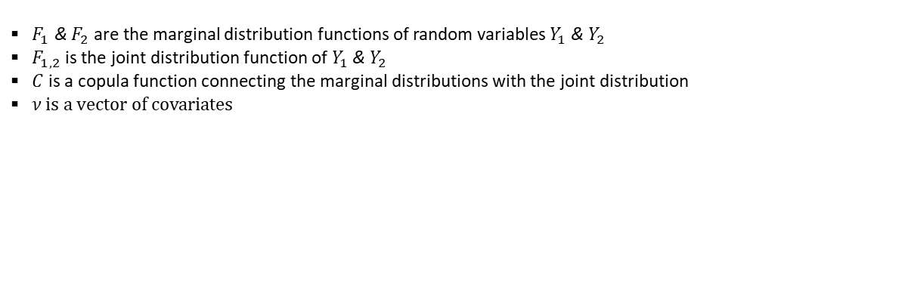
Modelling
Copulas are a framework which enable separation of the marginal distributions from the dependence structure
$F_{1}$ & $F_{2}$ are the marginal distribution functions of random variables $Y_{1}$ & $Y_{2}$
$F_{1,2}$ is the joint distribution function of $Y_{1}$ & $Y_{2}$
$C$ is a copula function connecting the marginal distributions with the joint distribution
$ν$ is a vector of covariates

Slide 9
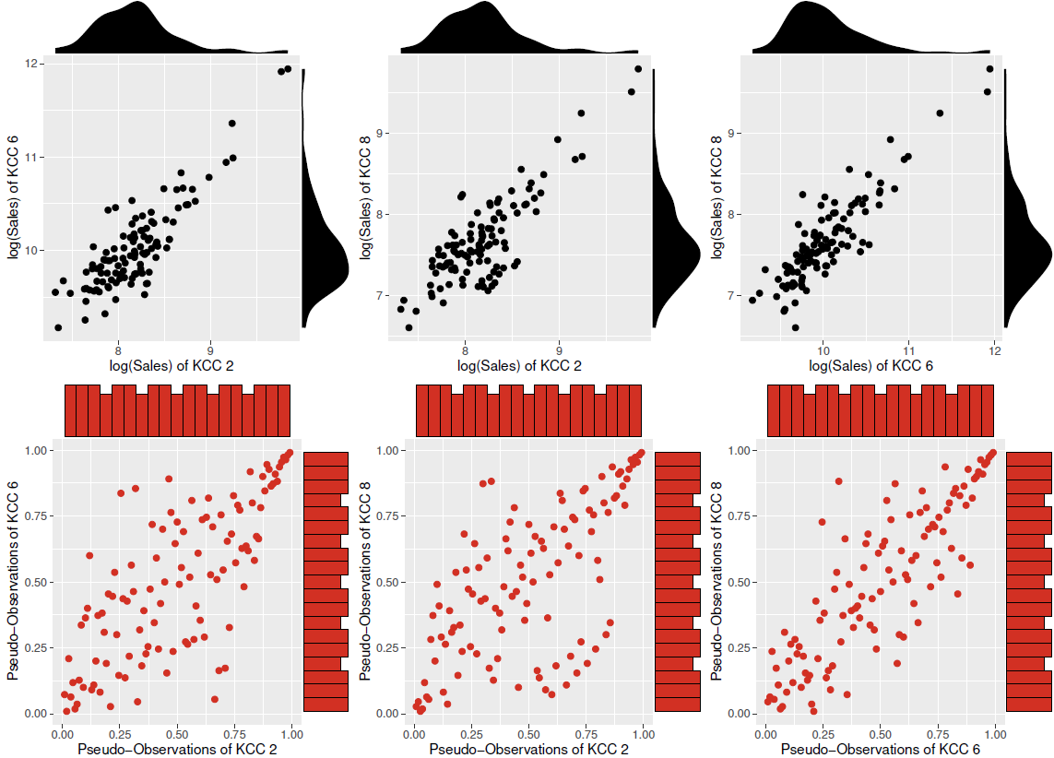
Modelling
Pairwise scatterplots of KCC
Upper row: Log-sales
Lower row: Pseudo-observations of sales
Modelling of the pairwise distributions of sale quantities on KCC level
Two-step approach:
Marginal distributions (GAMLSS)
Dependence structure of residuals (GJRM)

Slide 10
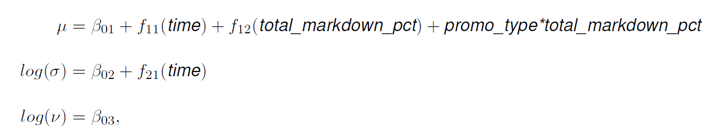
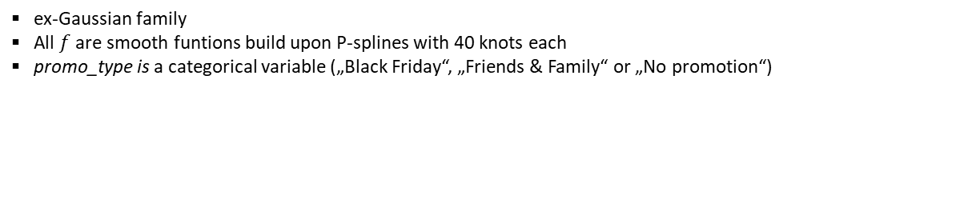
Modelling
Marginal Distribution of KCC 2 – GAMLSS
ex-Gaussian family
All $f$ are smooth funtions build upon P-splines with 40 knots each
promo_type is a categorical variable („Black Friday“, „Friends & Family“ or „No promotion“)

Slide 11
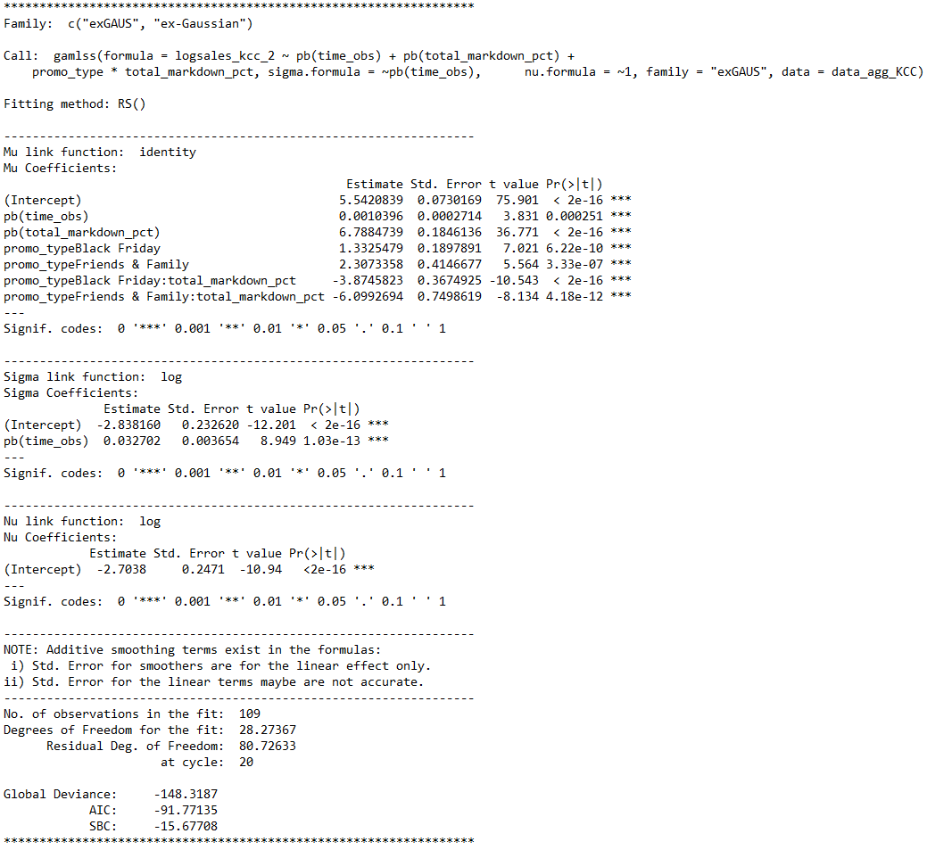
Modelling
Marginal Distribution of KCC 2 – GAMLSS
Odd negative coefficients of promotions interacting with total markdown percentage

Slide 12
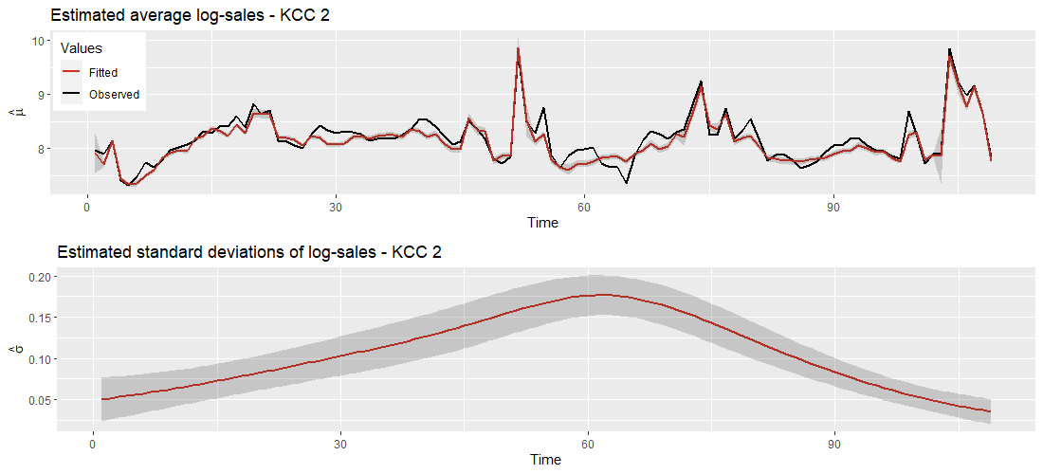
Modelling
Marginal Distribution of KCC 2 – GAMLSS
Fitted values & time-varying standard deviations of log-sales

Slide 13
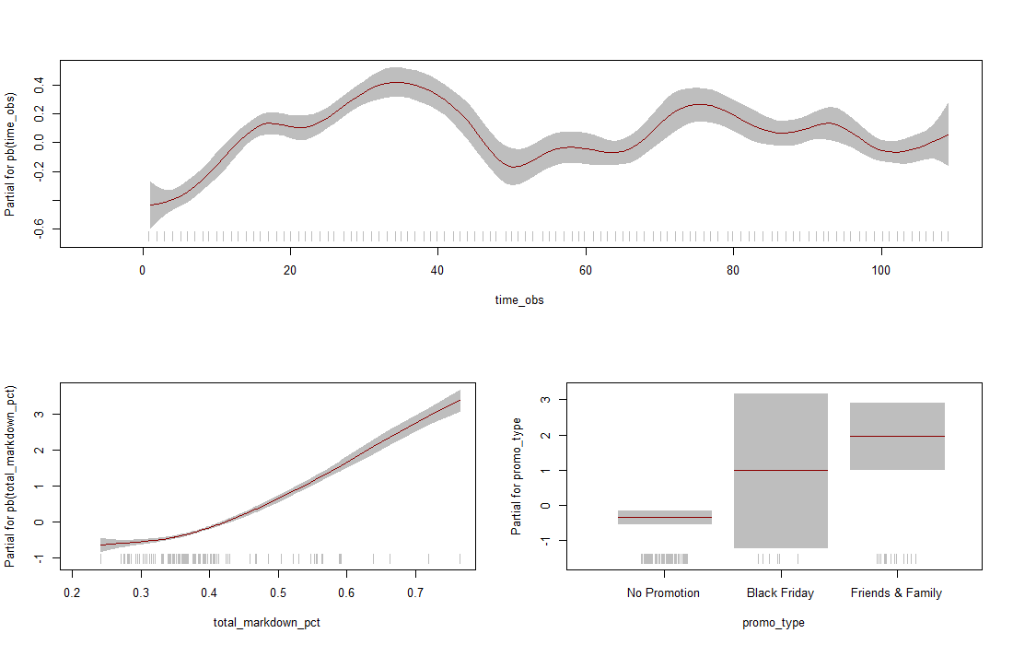
Modelling
Marginal Distribution of KCC 2 – GAMLSS
Partial covariate effects on expected value

Slide 14
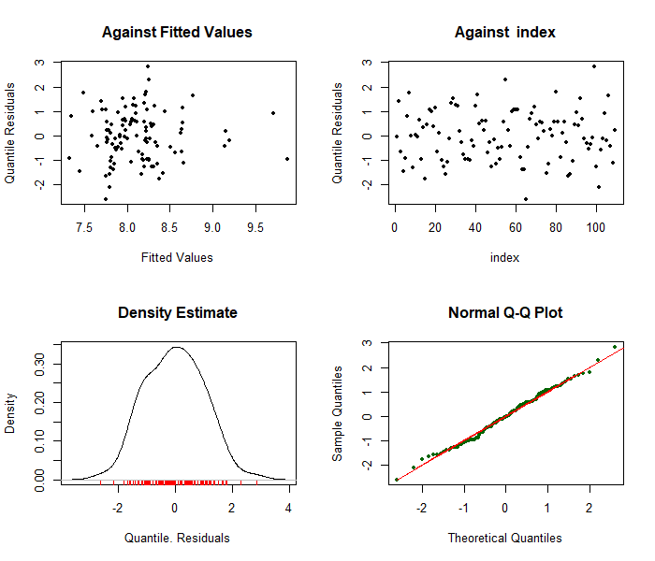
Modelling
Marginal Distribution of KCC 2 – GAMLSS
Diagnostic plots of residuals

Slide 15
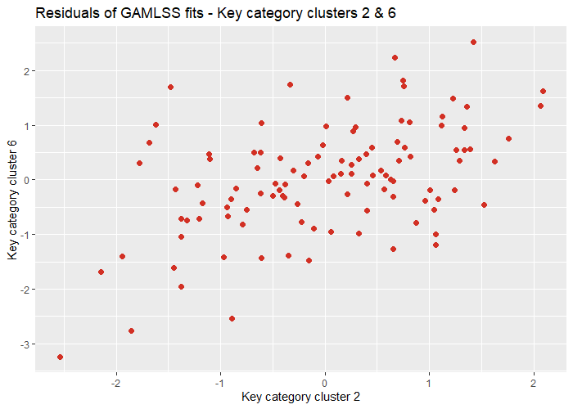
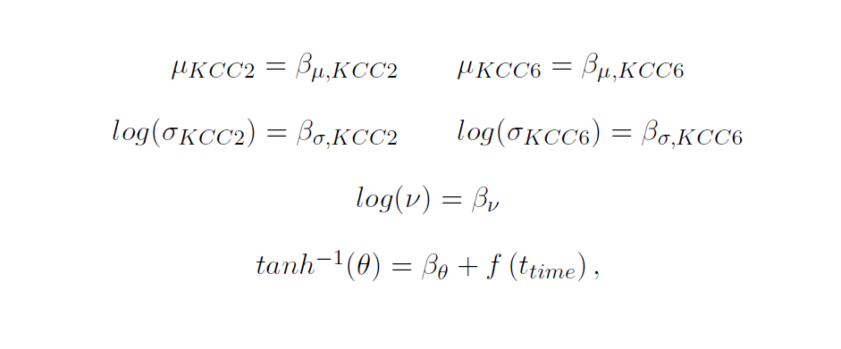
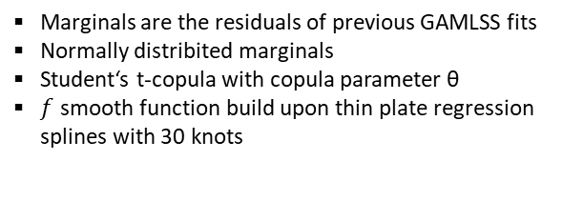
Modelling
Joint Distribution of KCCs 2 & 6 – GJRM Generalized Joint Regression Models
Marginals are the residuals of previous GAMLSS fits
Normally distribited marginals
Student‘s t-copula with copula parameter θ
$f$ smooth function build upon thin plate regression splines with 30 knots

Slide 16
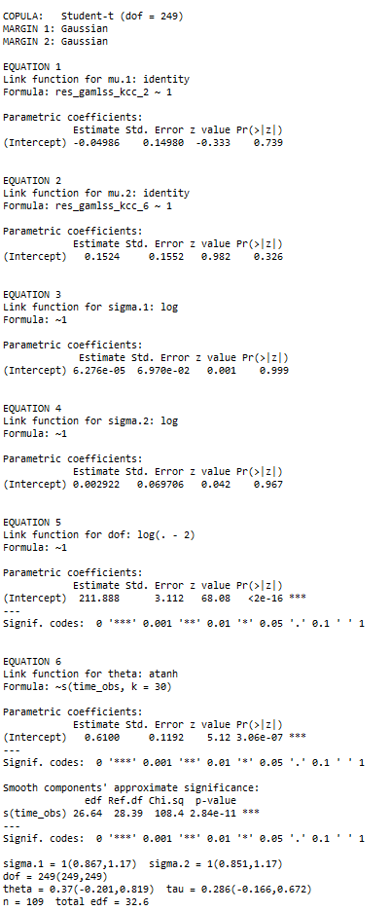
Modelling
Joint Distribution of KCCs 2 & 6 – GJRM Generalized Joint Regression Models
Summary output

Slide 17
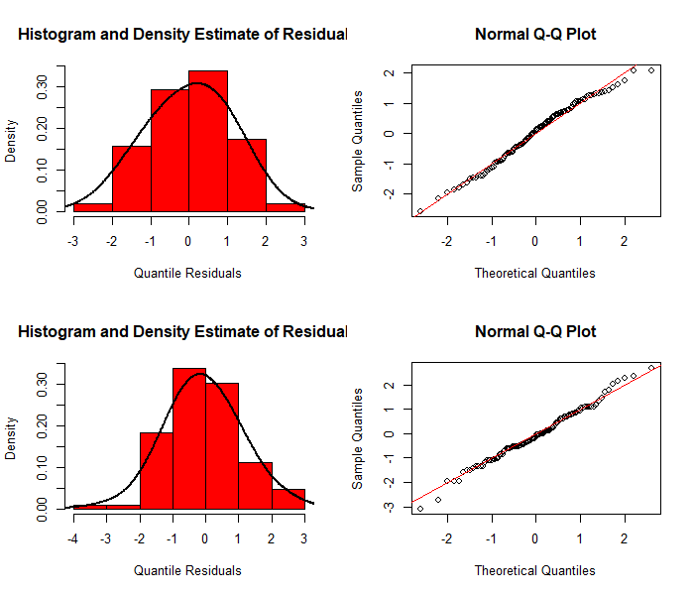
Modelling
Joint Distribution of KCCs 2 & 6 – GJRM Generalized Joint Regression Models
Diagnostic plots of residuals

Slide 18
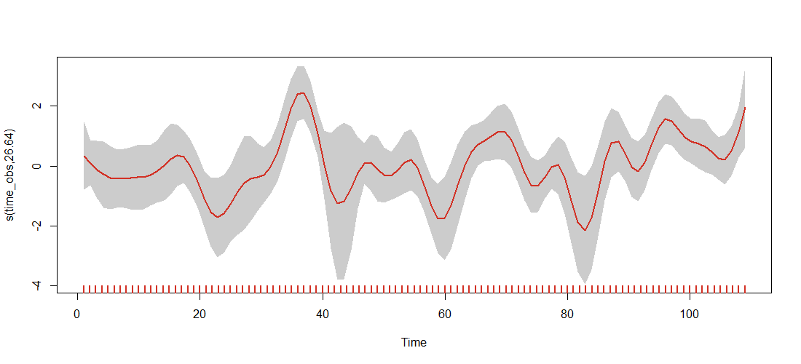
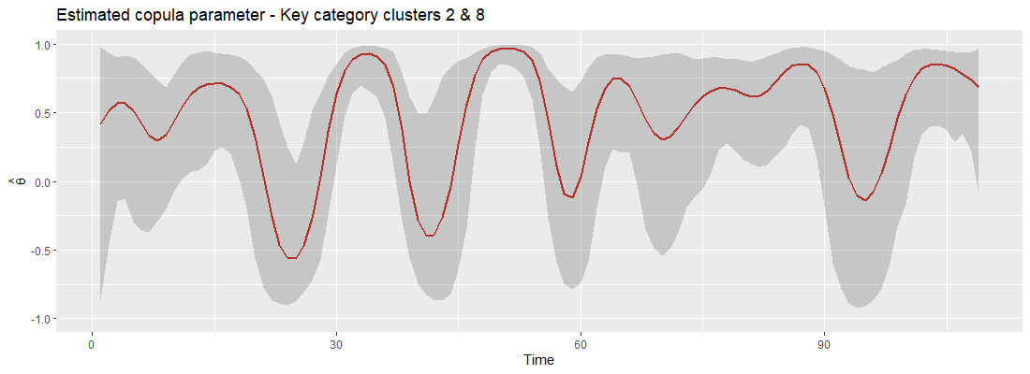
Modelling
Joint Distribution of KCCs 2 & 6 – GJRM Generalized Joint Regression Models
Effect of time on the copula parameter θ
Estimated time-varying copula parameter
Note: Correlation does not imply causation!

Slide 19
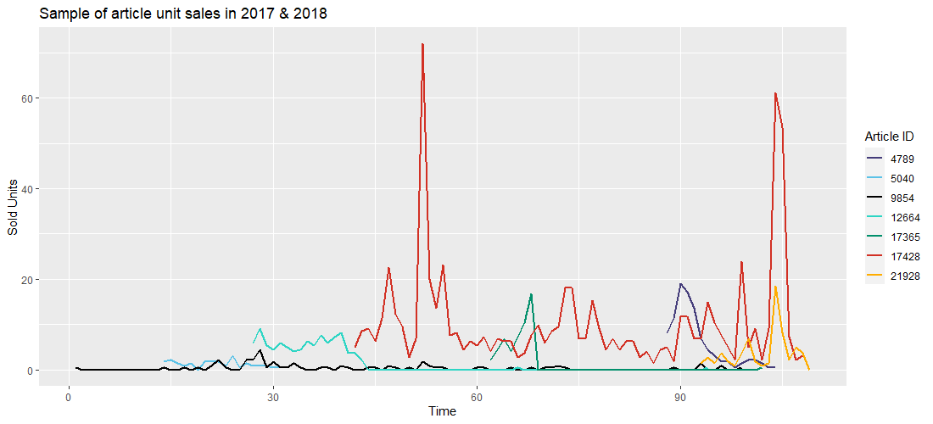
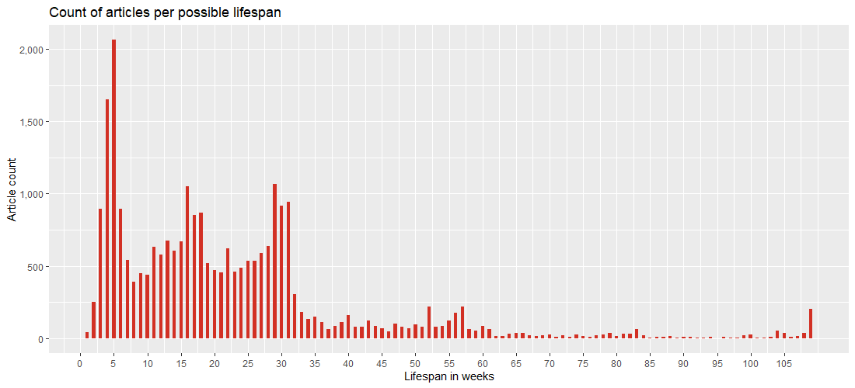
Modelling
Modelling dependencies between individual article sales
Challenges:
Poor lifespan of articles
Zero inflation
Desirable question to be answered:
What does the sales cannibalization between individual articles look like?
How many units transfer from one article‘s sales to another one?
Need to move beyond correlation measures

Slide 20

Summary & outlook
Dependence structures between aggregate sets of unit sales (KCC) can be modelled parametrically
GAMLSS for marginal distributions of KCCs
GJRM of residuals for correlation structures
High level of difficulty applying the same strategy for unit sales of distinct articles
Aim for sales transferability of distinct articles
Cannot infer causation from correlation
Outlook: Bayesian networks

Slide 21

Thank you!

